Slide 1

Green Pace
Security Policy Presentation
Developer: Mitchell Cabral

Slide 2

OVERVIEW: DEFENSE IN DEPTH
Defense in Depth means to make sure that security is priority and has multiple layers to ensure the best protection possible for the company.

Slide 3
THREATS MATRIX
The following are the major code standards rankings according to how likely it to happen.
Likely STD-003-CPP, STD-004-CPP, STD-005-CPP, STD-008-CPP, STD-010-CPP | Priority ALL
Low priority STD-002-CPP, STD-007-CPP | Unlikely STD-001-CPP, STD-006-CPP, STD-009-CPP

Slide 4
10 PRINCIPLES
Validate Input Data: STD-008-CPP
Heed Compiler Warnings: STD-002-CPP, STD-006-CPP
Architect and Design for Security: STD-003-CPP, STD-004-CPP, STD-010-CPP
Keep It Simple: STD-001-CPP, STD-003-CPP
Default Deny:
Adhere to the Principle of Least Privilege: STD-009-CPP
Sanitize Data Sent to Other Systems:
Practice Defense in Depth: STD-004-CPP
Use Effective Quality Assurance Techniques: STD-005-CPP
Adopt a Secure Coding Standard: STD-007-CPP

Slide 5
CODING STANDARDS
STD-001-CPP: Obey the one definition rule.
STD-002-CPP: Do not declare or define a reserved identifier
STD-003-CPP: Do not attempt to create a std::string from front a null pointer.
STD-004-CPP: Prevent SQL Injection.
STD-005-CPP: Properly deallocate dynamically allocated resources.
STD-006-CPP: Use a static assertion to test the value of a constant expression.
STD-007-CPP: Honor exception specifications.
STD-008-CPP: Use valid references, pointers, and iterators to reference elements of a basic_string.
STD-009-CPP: Pass an object of the correct type to va_start.
STD-010-CPP: Do not subtract iterators that do not refer to the same container.

Slide 6
ENCRYPTION POLICIES
At Rest: Encryption at rest will protect data while it is stored no matter where that is such as in the cloud, phone, etc.
In Flight: Encryption in flight is the practice of sending data through a secure channel. Should be used whenever possible for any company information being transferred to prevent leaks or unauthorized access.
In Use: Encryption in use is the practice of keeping memory data encrypted even while it is being used. This can help prevent forced crashes that cause memory loss. This should be used on all company data.

Slide 7
TRIPLE-A POLICIES
Authentication: Authentication verifies a user's identity credentials. There are several ways to implement this such as username/password logins, digital certificates, etc. All users should be verified to prevent theft or unauthorized users.
Authorization: Authorization is used to define the level of access to a system of files. Users will be checked for authorization before gaining access to any of the company files.
Accounting: Accounting is the records, or log files that detail what users have been doing. This would keep track of what is going on such as when a new user is created, whose accessing what, etc.

Slide 8
Unit Testing
The following are unit tests that test different properties of a collection object. This will show a variety of examples on how unit test work and why they are effective.

Slide 9
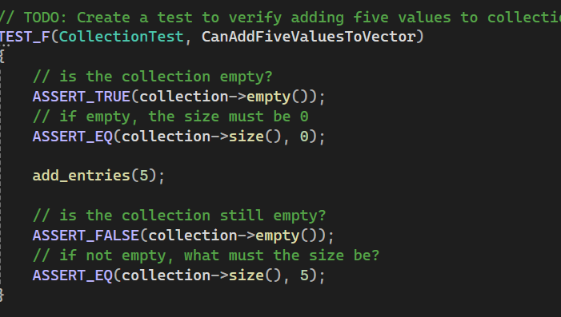
Verify adding a five values to a collection
This test here verifies that five values can be added to an empty collection

Slide 10
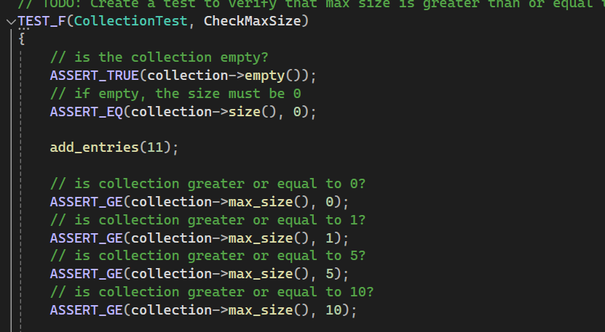
Verifying that max size is greater than entries
This is a unit test checking if the max value is greater than the existing entries

Slide 11
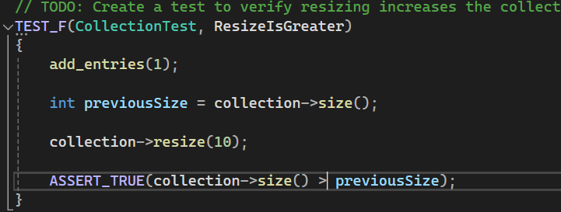
Verify that resizing increases the collection
This checks to make sure that resizing increases the collection.

Slide 12
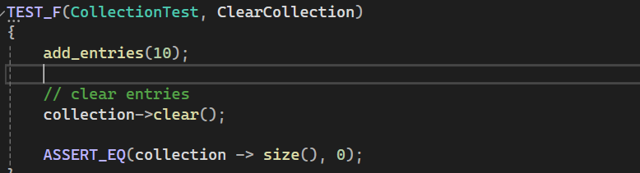
Verify that clear works
The following is a unit test checks to make sure that clear erases the collection

Slide 13

AUTOMATION SUMMARY

Slide 14
TOOLS
The DevSecOps pipeline is a integrating security measures into each step of the DevOps toolchain. This will allow security to become an important and key part in an ever-growing technological world. This will also make sure that the company is as protected as possible from outside threats.
There are a variety of tools that can be used to help with providing security coverage. Google testing framework for unit testing C++ applications. CPPChecker for static code analysis. Theseare just a few of the software tools for development.

Slide 15
RISKS AND BENEFITS
There are many benefits associated with adopting a security first approach. A big benefit is consumer confidence. The more trusting the consumer is to your product the more likely they are to use your company.
There are many risks involved in adopting a security policy. Just having user authentication isn’t enough. You need be cautious of cyber attacks because in today's world they happen all the time.

Slide 16
RECOMMENDATIONS
Check all compiler errors in code and run the code through a static code analysis program. This will verify the risks in the code and help you with fixing them.
Enact account authorization and authentication. This can make sure that when one user is hacked it does not compromise the whole system.
Security training for all employees. Keeping up with training for staff will ensure they know the proper precautions when dealing with possible attacks.

Slide 17
CONCLUSIONS
Defense in Depth: This is necessary, having multiple layers of coverage will help prevent attacks and mitigate slight attacks.
DevSecOps: Moving to a DevSecOps model will help ensure that security is a priority in all rollouts and development.
Authentication and Authorization: Making sure you validate who uses the systems and what can access are very important for protecting data.

